Slide 1
Best Start transition to school
A positive start for all children

Slide 2
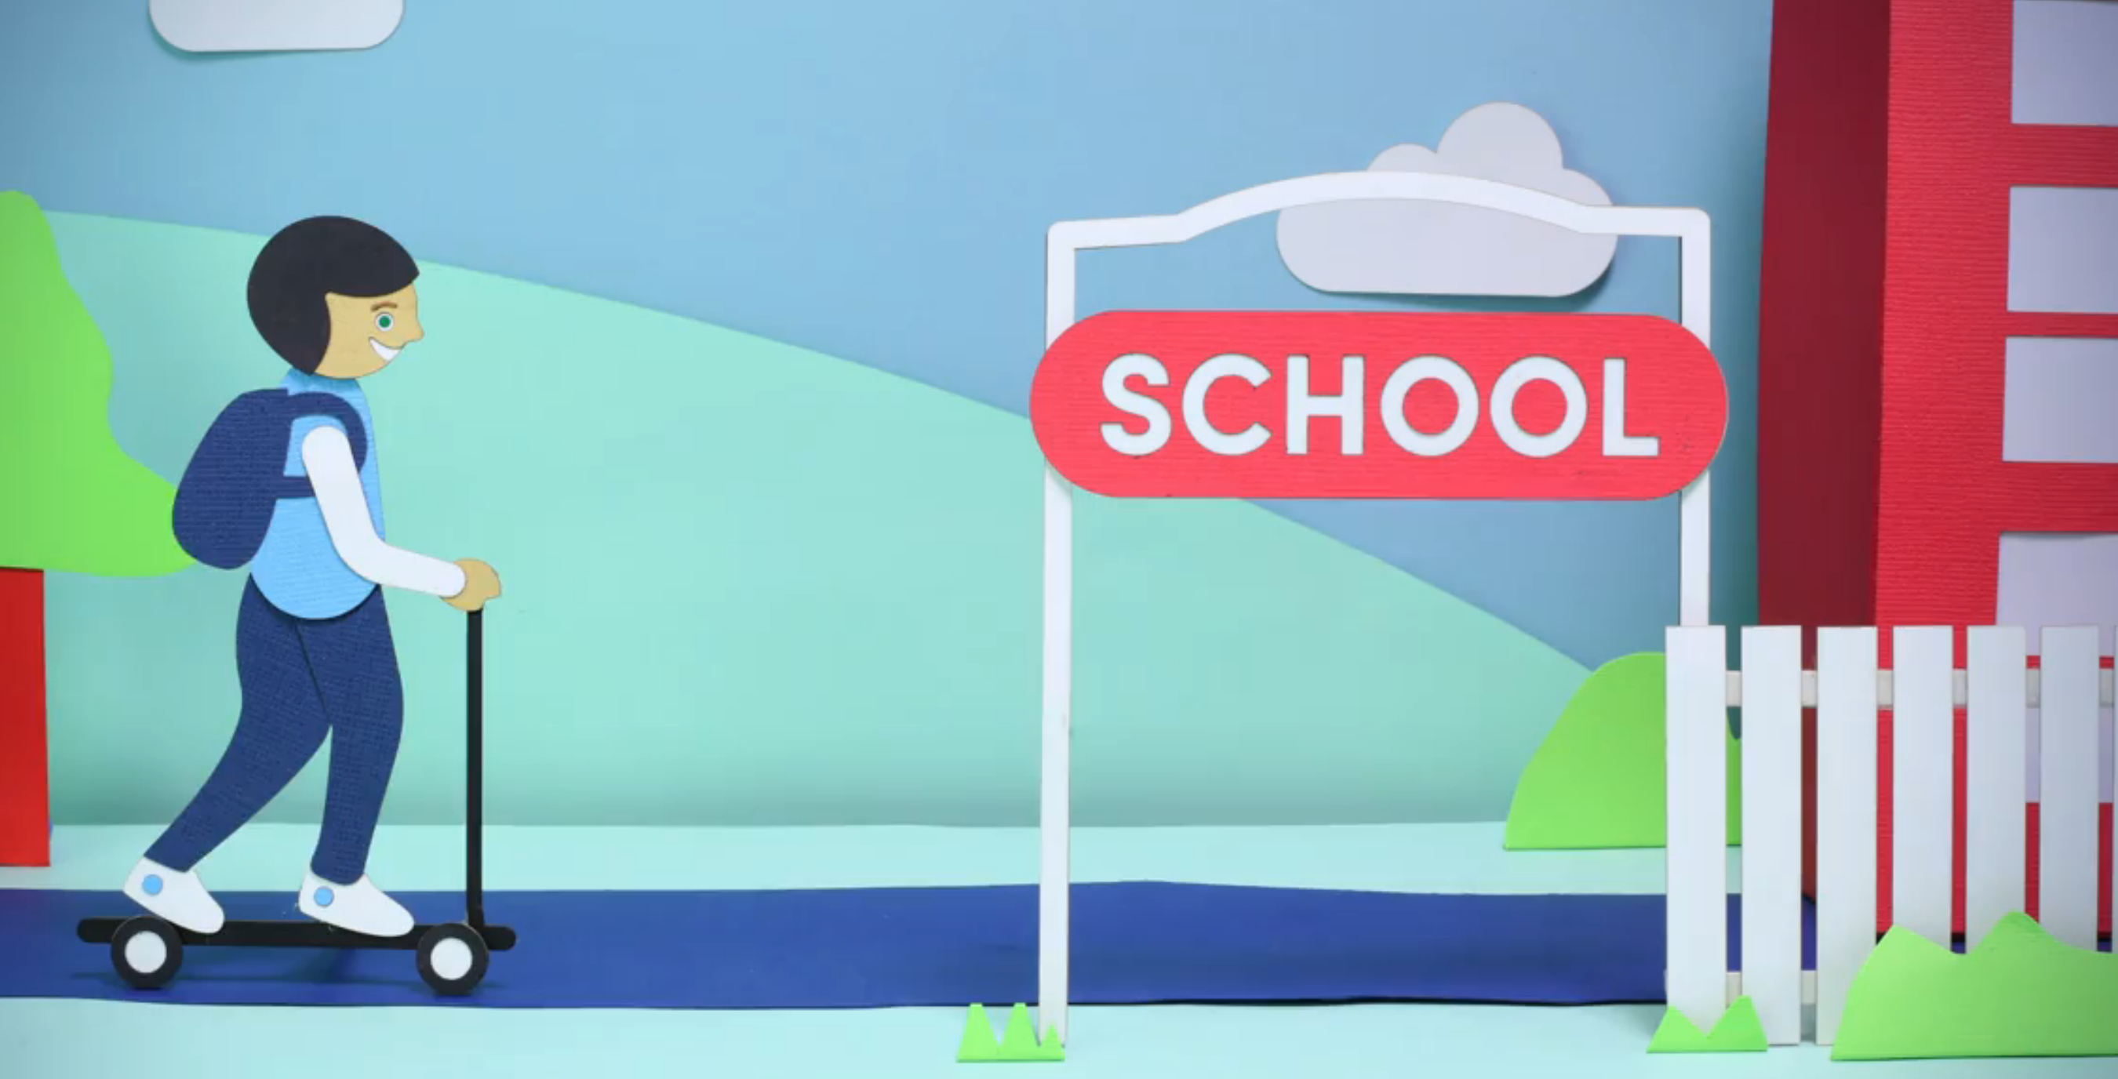
Welcome
2
Notes:
Schools add school logo and information

Slide 3
Acknowledgement of Country
I acknowledge the traditional Custodians of this Land, where the Aboriginal people have performed age-old ceremonies of storytelling, music, dance and celebration.
I acknowledge and pay respect to the Elders past and present and to those of the future, for they will hold the memories, traditions and hopes of Aboriginal Australia.
We must always remember that under the concrete and asphalt, this land is, was and always will be, traditional Aboriginal land.
Notes:
Read through slide

Slide 4
Continuity of learning and transitions
‘Building on children’s prior and current experiences helps them to feel secure and confident and connected to familiar people, places, events and understandings.’
The Early Years Learning Framework for Australia
Children start school with having many and varied experiences that have developed and shaped their language, literacy and numeracy knowledge from within their family and community.
4
Notes:
Acknowledge parents as the child’s first teacher and that children commence school with a variety of skills as well as experiences and knowledge.
Introduce that transition is a continuum of learning.
*Acknowledge that parents are a child’s prime educator/ first teacher and that they have supported their child’s development in all areas since birth.
*The community, including prior to school services have also provided stimulating and rich experiences contributing to developing many skills in the children entering Kindergarten
* A ready school- why Best Start is so important. The school prepares itself with the information to program appropriately for each Kindergarten child

Slide 5
Skills children bring to school
Children commence school with ways of communicating. They communicate in verbal and non-verbal ways with others for a range of purposes:
They can engage with a range of texts and gain meaning from these. Texts include books and environmental texts for example road signs
Each child can express ideas and make meaning using a range of media
Begin to understand how symbols and patterns systems work
Use information and communication technologies to access information, investigate ideas and represent their thinking
The Early Years Learning Framework for Australia
6
Notes:
Read through slide

Slide 6
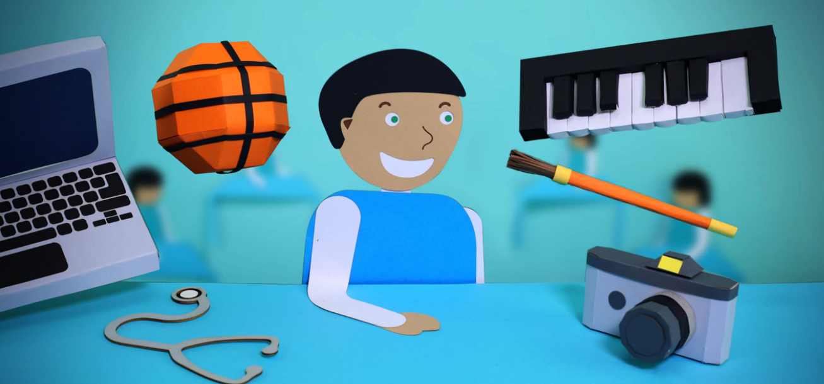
Prior to school experiences
In the prior to school environment parents and carers as well as educators are responsible for the learning, wellbeing and development of the child.
In early childhood settings, children engage in a range of play-based learning that is tailored and centred on learning through exploring their interests.
Educators plan opportunities for intentional teaching and knowledge building and encourage children to explore possibilities and to extend their thinking and learning.
Notes:
The continuity of learning continues from the home and prior school settings to school. These together build the solid foundation for the child’s subsequent success at school and for learning. That school continues the learning in a more formalised manner.
Play is important to the child’s development of self awareness and developing their knowledge of how they can interact in their world.
Play is endorsed by the United Nations Charter on the Rights of the Child. “ a child has the right to play and be actively involved in their world”

Slide 7
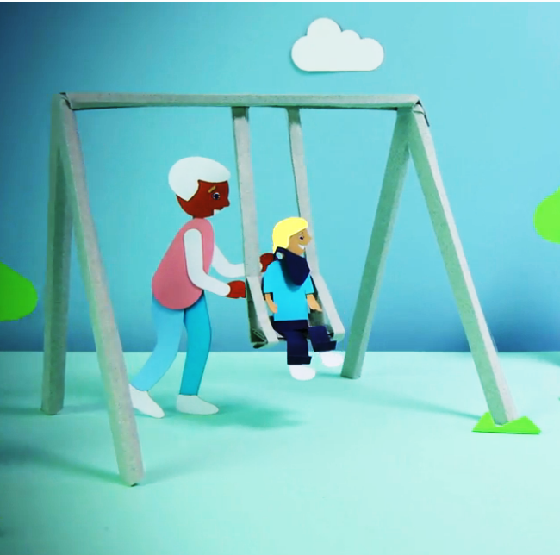
The importance of play
Play assists children to become engaged and successful learners.
Play encourages curiosity, problem solving, persistence, commitment, cooperation and resilience.
Play helps develop language and communication skills.
Play helps develop literacy and numeracy skills.
8
Notes:
Home corner- communication skills; social skills; fine motor skills; negotiating skills; numeracy skills
Blocks - cooperative skills; communication skills; numeracy skills; social skills;
Puzzles- problem solving skills; fine motor skills; attending and concentration skills;
Group time- attending and concentration skills; listening skills; questioning skills; expressing ideas; turn taking
Book corner- developing a love of reading; sharing ideas; acquiring new information;
Sand/water play- numeracy skills; social skills; etc
Outdoor activities- children use skills across settings; learn from the natural environment; gross motor skills
Craft activities- fine motor skills; writing; persistence; sharing;

Slide 8
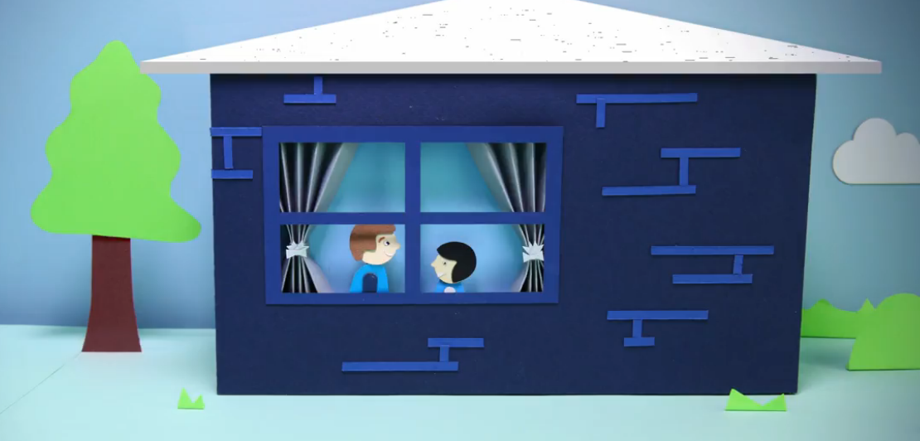
Quality transition to school
International research outlines that a smooth transition for all students is developed by:
Schools developing connections with each child and their family
Teachers building a respectful and happy relationship with every child
Collaboration between preschool and primary school teachers
An inclusive environment
Ongoing individualised learning and teaching practice.
Adapted from Starting Strong V Transitions from Early Childhood Education and Care to Primary Education OECD
Notes:
The approach that the school has taken to ensure a quality: smooth and seamless transition to school. With the child at the centre of the planning.
Schools may choose to watch the video on transition to school: DoE You Tube: https://www.youtube.com/watch?v=jSwR01Lcyv0
Kids Matter:
https://www.youtube.com/watch?v=UcINGGuysBE

Slide 9
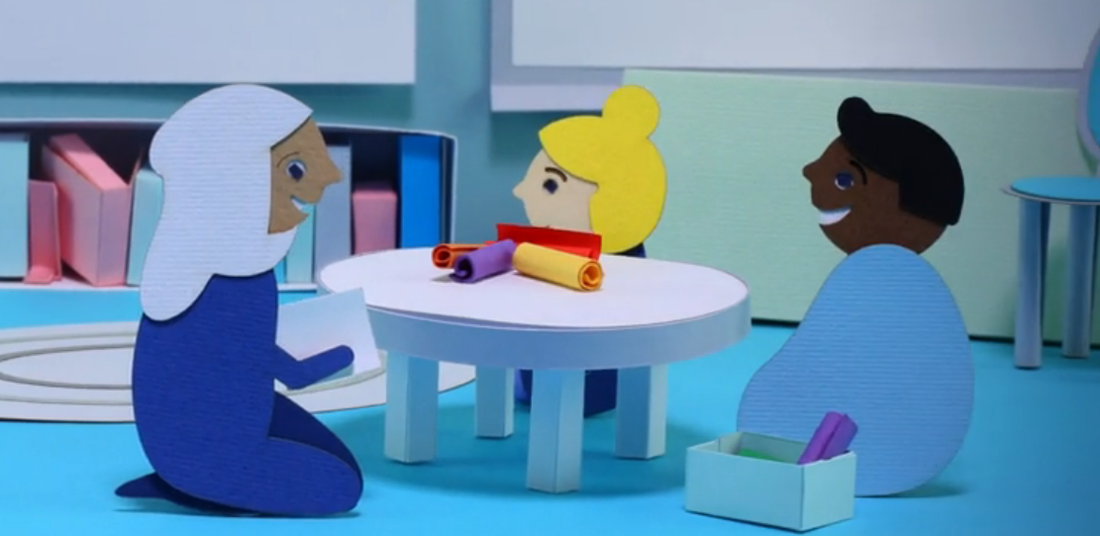
Best Start
Parents and prior to school service providers lay the foundation for learning that school education will build upon in a more formal setting.
Best Start assists children to move smoothly from informal to formal learning.
It is a time when teachers develop a relationship with each individual student in the classroom.
10
Notes:
Read through slide

Slide 10
Best Start
Is it a test?
No
Best Start is not a test. It is the classroom teacher working with each child on literacy and numeracy tasks to gain a starting point for planning effective teaching and learning activities. The children do not pass or fail.
There is no preparation required.
11
Notes:
Read through slide.

Slide 11
What is Best Start?
Best Start is one component of a NSW Government initiative to increase literacy and numeracy learning support in the early years of schooling.
Best start:
teachers gather and analyse information as evidence about what children know, can do and understand in Literacy and Numeracy.
provides important information that supports teachers in meeting children’s individual learning needs
provides families with feedback on what their child can do and how they can best support their child’s learning
assists teachers to monitor children’s learning. This is ongoing through out the child’s schooling years.
12
Notes:
Read through slide

Slide 12
Who is involved?
All Kindergarten children in public schools participate.
Administered by the classroom teacher in a classroom environment in the school.
Children complete most tasks individually with the teacher, though some tasks may take place in small groups.
Classroom teachers observe and record the child’s responses.
13
Notes:
Read through slide

Slide 13
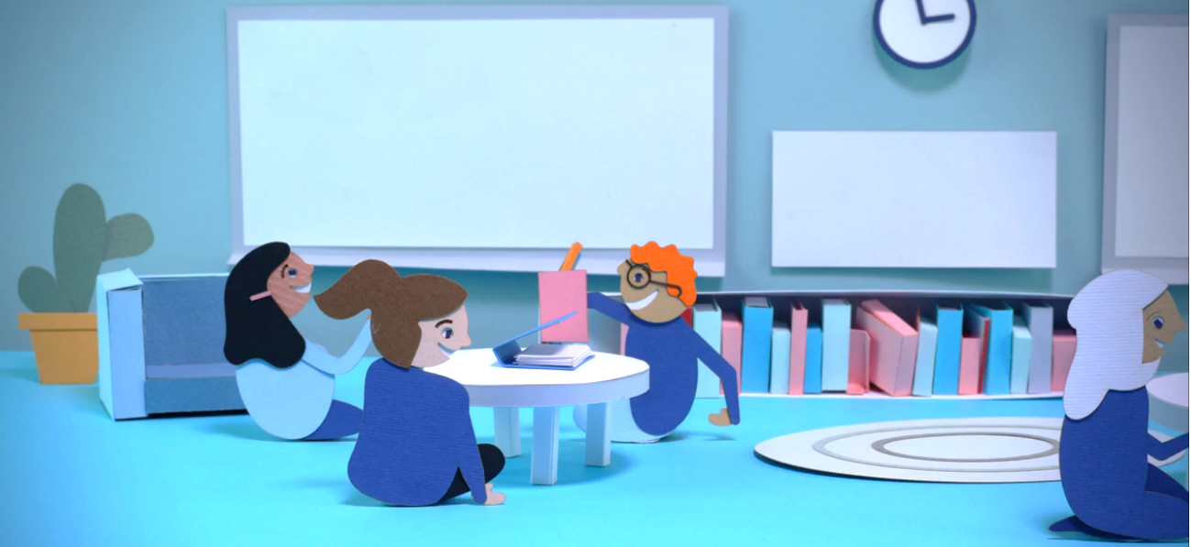
When and where is Best Start administered?
Best Start begins with the teacher interviewing each child at the beginning of the Kindergarten year.
The interview takes place in a supportive environment within the school. Children complete most tasks individually with the teacher, though some tasks may take place in small groups.
Classroom teachers observe and record the child’s responses.
14
Notes:
Read through slide

Slide 14
How is Best Start administered?
Teachers ask a series of questions to gather information about children’s early literacy and numeracy knowledge.
Teachers record directly into the Best Start software their observations and the child’s responses.
15
Notes:
Read through slide

Slide 15
Best Start: an example of a literacy question
Tell me what happened in the story.
16
Notes:
Schools can opt to hand out: Best Start Literacy and Numeracy Parent’s Guide

Slide 16
Best Start: An example of a numeracy question
Start counting and I will tell you when to stop.
17
Notes:
Read through slide

Slide 17
Best Start information
Teachers learn about each child’s school entry skills and understandings in literacy and numeracy and are able to plan effective teaching and learning programs in line with the NSW K-6 Syllabus.
Parents and carers may be sent a feedback summary report of their child’s responses in Best Start. You will be provided with feedback about how you can support your child during the first year of school.
18
Notes:
Read through slide
Schools can opt to observe video of My day at Kindergarten: https://education.nsw.gov.au/teaching-and-learning/curriculum/preschool/transition

Slide 18
Thank you
Thank you for your attendance. Together we will ensure a positive start for all children and their families and carers.
We at <INSERT SCHOOL NAME> and the community look forward to working with you and your children.
19
Notes:
Schools read through and adapt slide

